Slide 1
Lecture 1
Introduction to regression and interpolation

Slide 2
Representing data with models
The aim is to represent data by some mathematical model
Two approaches can be used
  Curve fitting (regression)
  Data interpolation
Even if both approaches have the same aim, they differ in their methodology and are applied in different situations
Notes:
In this lesson we are going to encounter a very different type of mathematical problems than we handled until now.
The problem we will discuss does, contrary to the case of solving equations, not have a clearly defined answer.
What we want to achieve is to represent data by a mathematical model
We will discuss two approaches:
Curve fitting
And data interpolation
As we will learn, both approaches have the same aim, but their methodology is very different to solve the problem.
They will as well reach a very different answer.

Slide 3
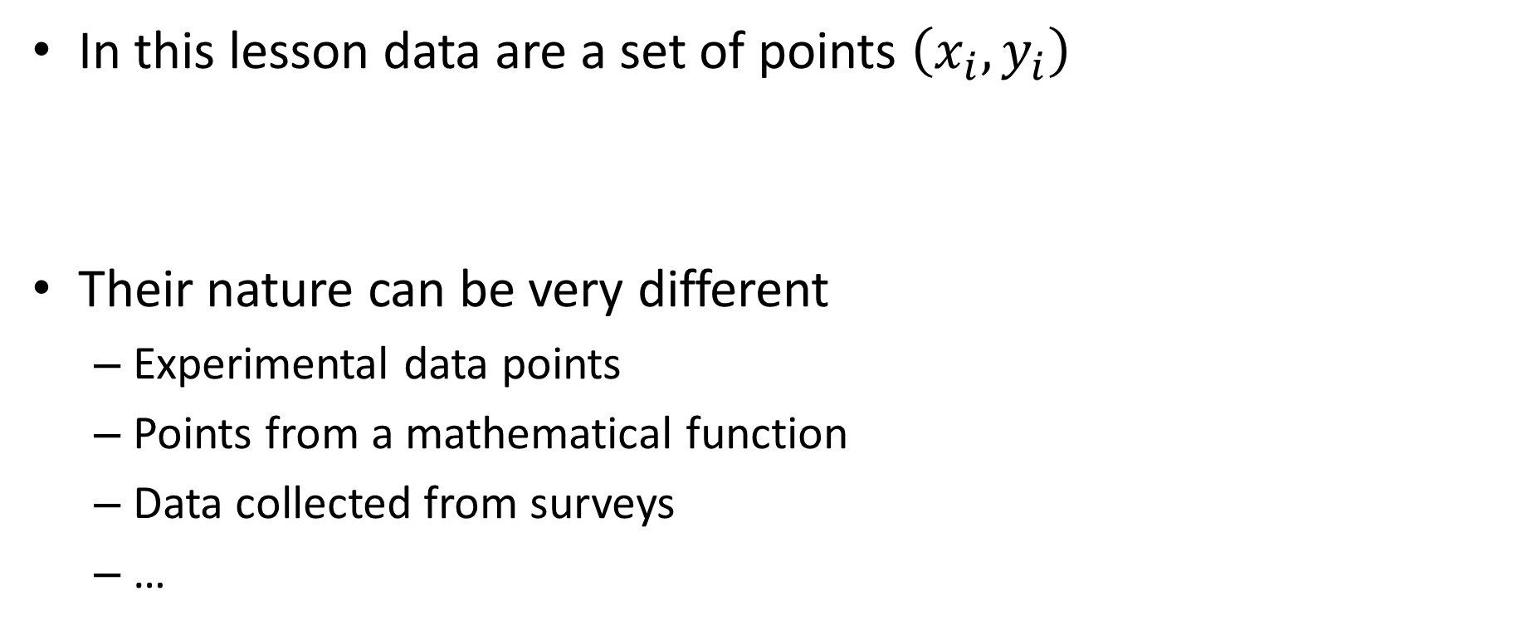
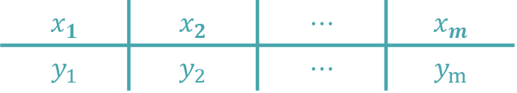
Data
In this lesson data are a set of points $\left(x_{i},y_{i}\right)$
Their nature can be very different
  Experimental data points
  Points from a mathematical function
  Data collected from surveys
  …
$$x_{1}$$ | $$x_{2}$$ | $$⋯$$ | $$x_{m}$$
$$y_{1}$$ | $$y_{2}$$ | $$⋯$$ | $$y_{m}$$
Notes:
Let us first clarify what do we mean by “data”
In this lesson, data is a set made of m of points (xi, yi)
Their nature can be very different such as
Experimental data points
Points from a mathematical function
Data collected from surveys

Slide 4
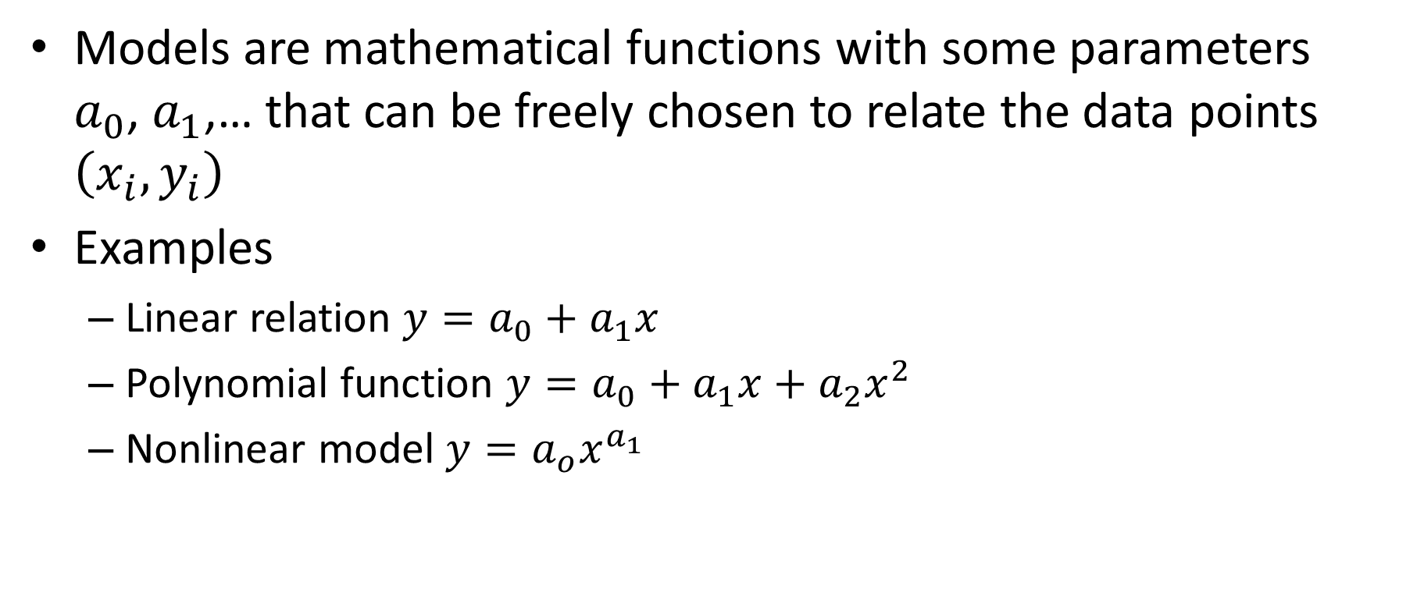
Models
Models are mathematical functions with some parameters
$a_{0}$, $a_{1}$,… that can be freely chosen to relate the data points $\left(x_{i},y_{i}\right)$
Examples
  Linear relation ${y=a}_{0}+a_{1}x$
  Polynomial function ${y=a}_{0}+a_{1}x+a_{2}x^{2}$
  Nonlinear model ${y=a}_{o}x^{a_{1}}$
Notes:
On the other side, a mathematical model is a function which has some parameters that we can freely choose.
The aim will be to develop methods that allow us to choose these parameters in a way that the function will represent as good as possible the data set.
Examples of model functions are
A linear relation ${y=a}_{0}+a_{1}x$
A polynomial function such as ${y=a}_{0}+a_{1}x+a_{2}x^{2}$
Or nonlinear functions such as for example ${y=a}_{o}x^{a_{1}}$
All these models contain some parameters that we will try to adjust to the data set.

Slide 5

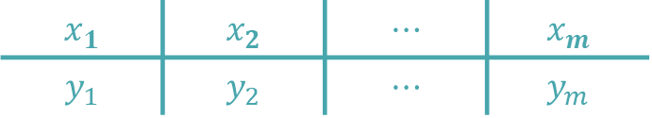

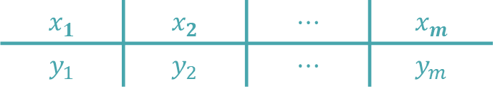





Regression versus interpolation
Regression
Interpolation
$$x_{1}$$ | $$x_{2}$$ | $$⋯$$ | $$x_{m}$$
$$y_{1}$$ | $$y_{2}$$ | $$⋯$$ | $$y_{m}$$
$$x_{1}$$ | $$x_{2}$$ | $$⋯$$ | $$x_{m}$$
$$y_{1}$$ | $$y_{2}$$ | $$⋯$$ | $$y_{m}$$
$$y=f\left(x;a_{0},a_{1},…,a_{n}\right)$$
$$n+1<m$$
$$y=f\left(x;a_{0},a_{1},…,a_{m−1}\right)$$
$$y_{i}$$
$$y_{i}$$
$$x_{i}$$
$$x_{i}$$
Notes:
Let us now compare the two approaches
We start by the methodology of regression
We have our data set made out of m data points.
We have as well our mathematical model with n+1 parameters ai.
For regression, the number of parameters will always be less than the number of data points.
Because of this condition, it is impossible that the function pass exactly by all data points.
It will only be possible to find parameters ai, such that the function passes as close as possible to most of these data points.
Let us now discuss the second approach which is interpolation
Again we have our m data points
We have as well a mathematical model.
But this time we have the same number of parameters ai than data points.
Because we have the same number of parameters than data points, it is possible to choose these paramters such that the model will pass exactly across each data point.
Comparing both approaches it is obvious that their solution will be different.
A question may raise immediately:
When does one use regression and when does one prefer interpolation?

Slide 6
Cases where regression is used
Adjust a physical law to experimental data
Determination of some parameters based on a theoretical relationship and experimental data
Machine learning
Notes:
Regression is typically used when one wants
To adjust a physical law to experimental data
For example you want to verify if some experiment can confirm a physical law.
It is as well used when one wants to determine some parameters based on a theoretical relationship and experimental data
A typical example is the measurement of a resistor. You can record the current I flowing in a resistor R in function of various potentials V applied to it.
Using ohm’s law V=R*I, you can then find the resistor by adjusting this model to the measured data
Another typical case of use for regression is machine learning, a topic we are going to discuss in the next lesson.

Slide 7
Cases where interpolation is used
Estimation of missing data points
Representing a mathematical function by an other one
Key component of numerical integration algorithms
Notes:
Interpolation is used when one want to estimate missing data points.
A typical example is in probability in statistics when you want to use probability tables listing the surface bellow the Gauss distribution.
The table, even containing several entries, will of course never contain exactly the case you want. By interpolation you can find the missing entry
Interpolation is as well used to replace a function by another one.
Imagine you want to compute the cosine function. You could interpolate the cosine by some polynomial model to estimate the value of, for example cosine of 0.5.
As we will learn later in the semester, interpolation is as well a key component in developing numerical integration algorithms.

Slide 8
Summary
Regression and interpolation aim to represent data by a mathematical model
Their approach is different:
  Regression: aims to adjust a mathematical as good as possible to the data
  Interpolation: aims to adjust exactly a mathematical model to the data
Notes:
Let us summarize the key findings
Regression and interpolation aim to represent data by a mathematical model
Their approach is different:
Regression aims to adjust a mathematical as good as possible to the data
Whereas interpolation aims to adjust exactly a mathematical model to the data

